Slide 1
Coding Theory
With a closer look at Reed-Solomon codes
Augustine Calvino
MATH 4930 – Directed Research

Slide 2
What is Coding Theory?
Definition:
Mathematical methods for error detection and correction in data transmitted through noisy channels.
Notes:
Explain noise.
Give examples of such channels (dust on a cd, random disruptions of frequency in the air, satellites in deep space, human error such as typing in the wrong number).
Detection, Correction

Slide 3
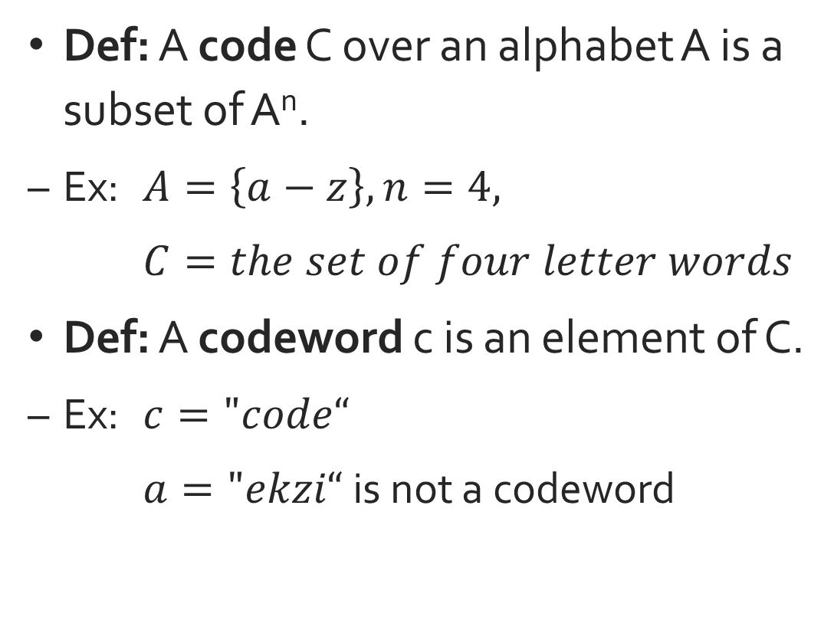
Codes
Def: A code C over an alphabet A is a subset of A^{n}.
Ex: $A=\left\{a−z\right\},n=4,$
$C=the set of four letter words$
Def: A codeword c is an element of C.
Ex: $c="code“$
$a="ekzi“$ is not a codeword
Notes:
Explain “alphabet”.
Conditions for a vector subspace

Slide 4
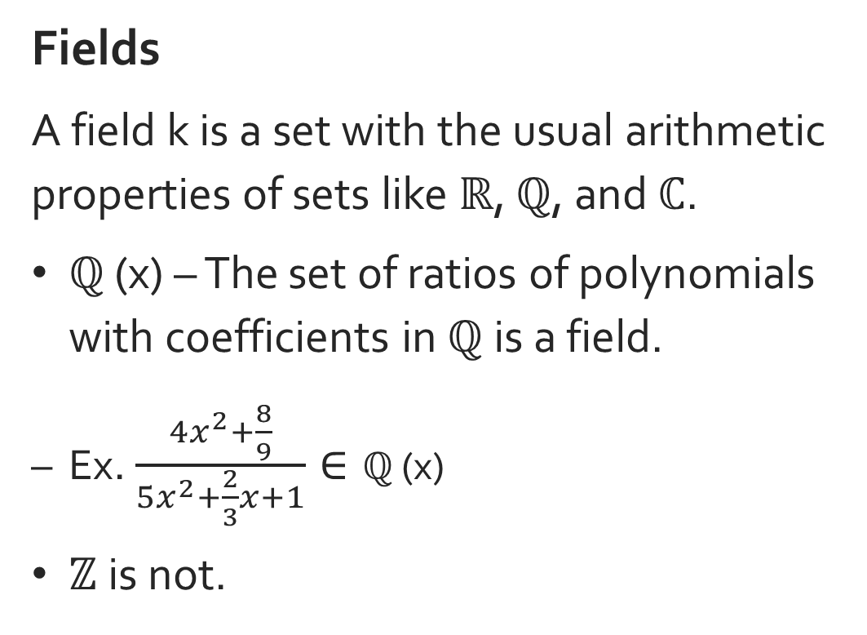
Mathematical Background in abstract algebra
Fields
A field k is a set with the usual arithmetic properties of sets like ℝ, ℚ, and ℂ.
ℚ (x) – The set of ratios of polynomials with coefficients in ℚ is a field.
Ex. $\frac{4x^{2}+\frac{8}{9}}{5x^{2}+\frac{2}{3}x+1}∈\text{ℚ}\text{ (}\text{x}\text{)}$
ℤ is not.
Notes:
Commutativity of Addition
Associativity of addition
Additive identity
Additive inverse
Distributiivity
Scalar identity

Slide 5
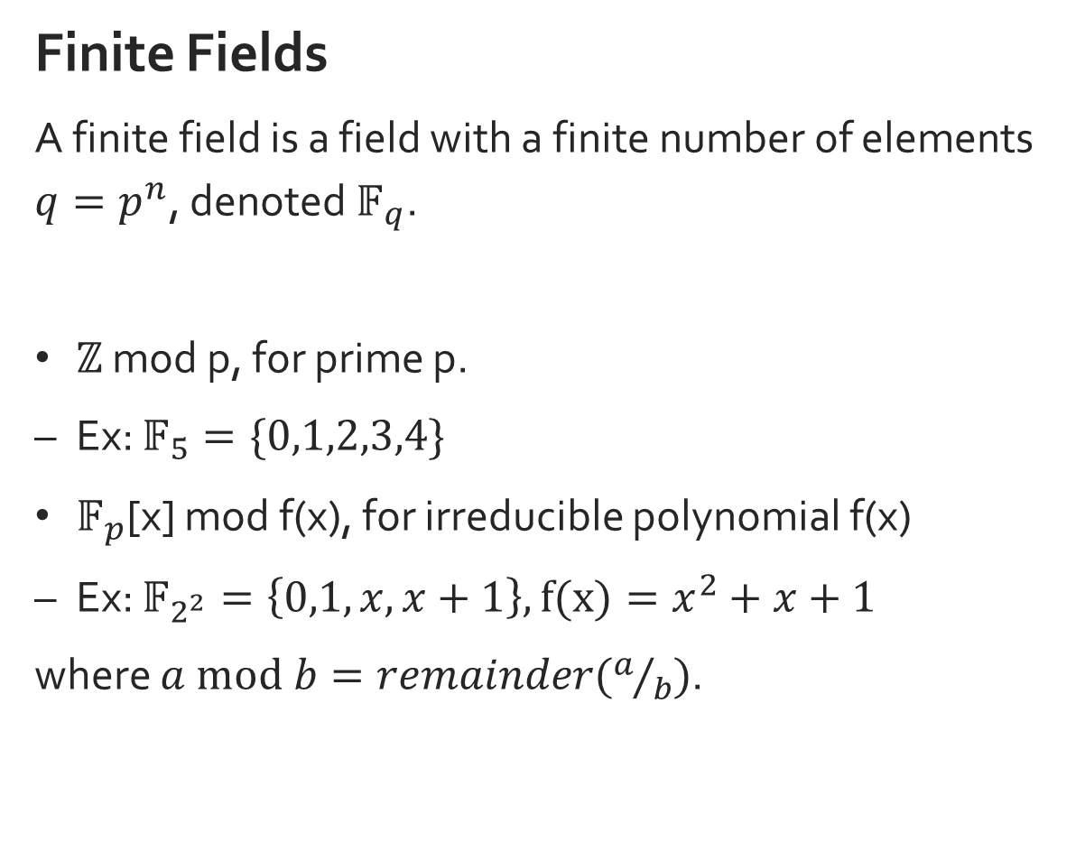
Mathematical Background in abstract algebra
Finite Fields
A finite field is a field with a finite number of elements $q=p^{n}$, denoted $𝔽_{q}$.
ℤ mod p, for prime p.
Ex: $𝔽_{5}=\{0,1,2,3,4\}$
$𝔽_{p}$[x] mod f(x), for irreducible polynomial f(x)
Ex: $𝔽_{2^{2}}=\left\{0,1,x,x+1\right\}, f(x)=x^{2}+x+1$
where $a mod b=remainder(a/b)$.
Notes:
Commutativity of Addition
Associativity of addition
Additive identity
Additive inverse
Distributiivity
Scalar identity

Slide 6
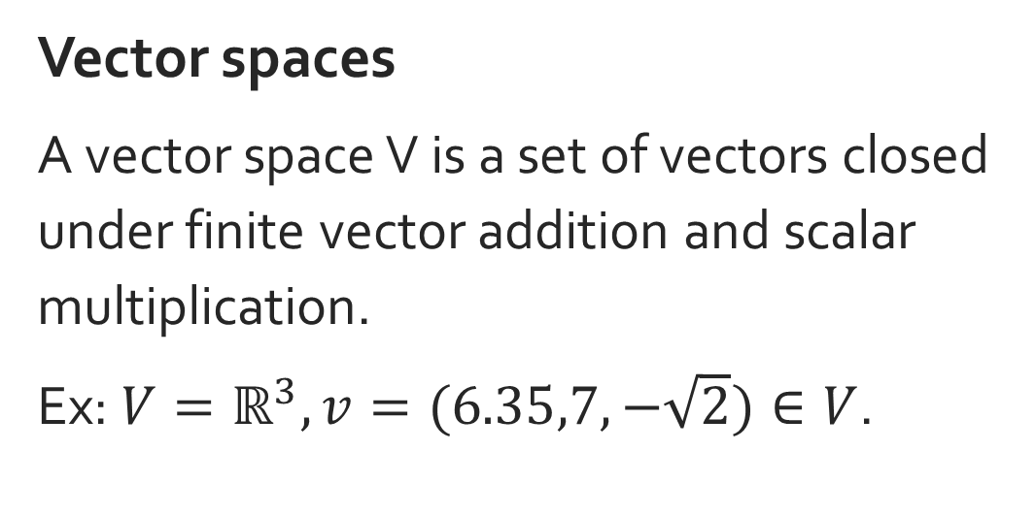
Mathematical Background in abstract algebra
Vector spaces
A vector space V is a set of vectors closed under finite vector addition and scalar multiplication.
Ex: $V=ℝ^{3}, v=(6.35,7,−\sqrt{2})∈V$.
Notes:
Commutativity of Addition
Associativity of addition
Additive identity
Additive inverse
Distributiivity
Scalar identity

Slide 7
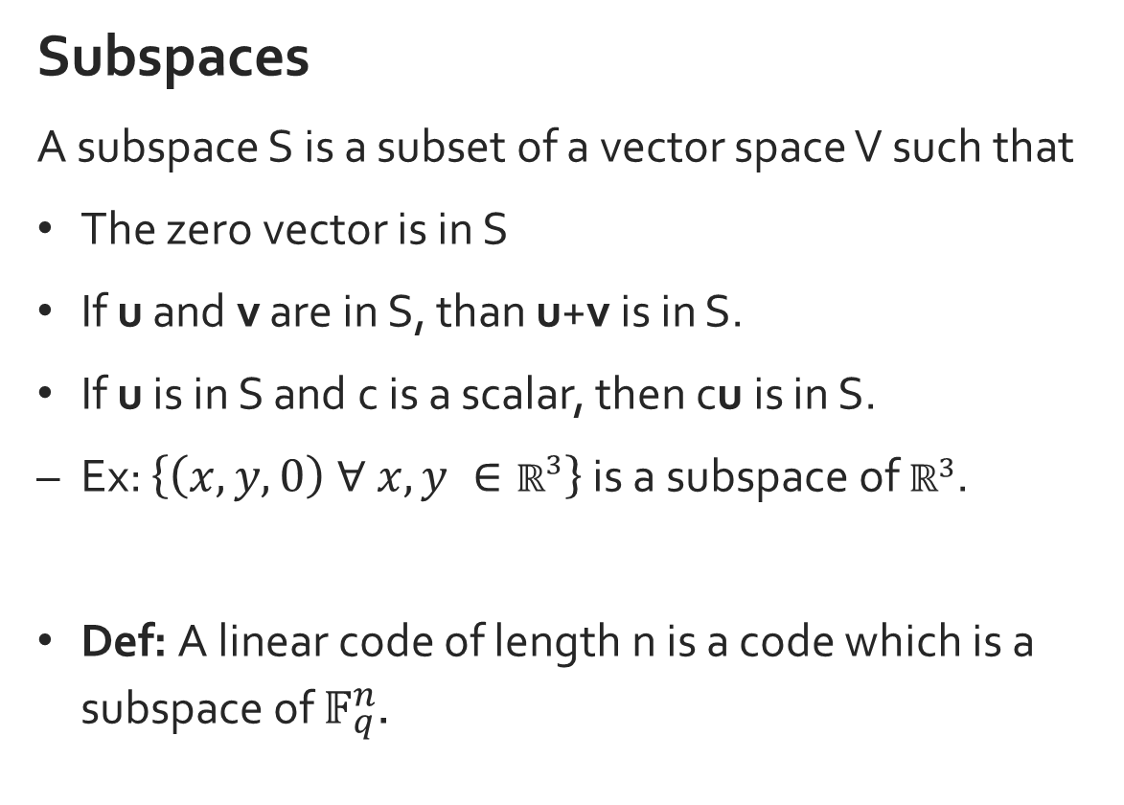
Mathematical Background in abstract algebra
Subspaces
A subspace S is a subset of a vector space V such that
The zero vector is in S
If u and v are in S, than u+v is in S.
If u is in S and c is a scalar, then cu is in S.
Ex: $\left\{\left(x,y,0\right) ∀ x,y ∈ℝ^{3}\right\}$ is a subspace of $ℝ^{3}$.
Def: A linear code of length n is a code which is a subspace of $𝔽_{q}^{n}$.
Notes:
Commutativity of Addition
Associativity of addition
Additive identity
Additive inverse
Distributiivity
Scalar identity

Slide 8
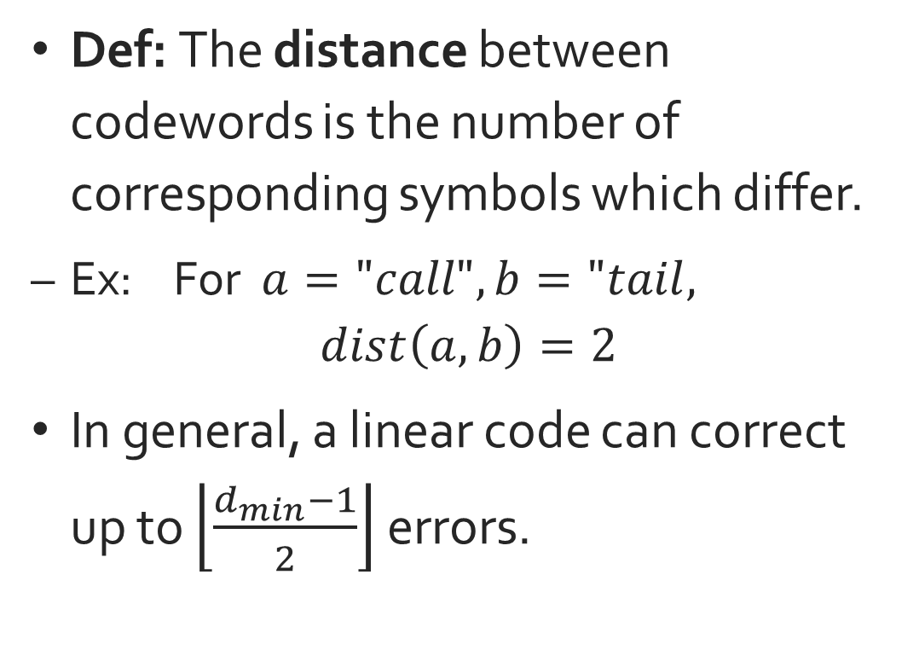
Codes Distance
Def: The distance between codewords is the number of corresponding symbols which differ.
Ex: For $a="call", b="tail,$
$$dist\left(a,b\right)=2$$
In general, a linear code can correct up to $\left\lfloor \frac{d_{min}−1}{2}\right\rfloor$ errors.
Notes:
Explain “alphabet”.
Conditions for a vector subspace

Slide 9

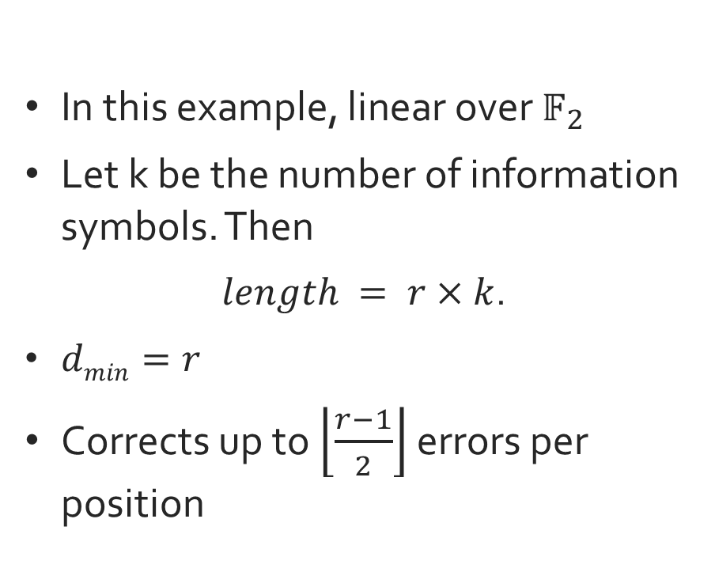
Example Codes
Repetition
A string of data repeated r times.
Ex:
$$R\left(12,4\right): 1011→1011 1011 1011$$
In this example, linear over $𝔽_{2}$
Let k be the number of information symbols. Then
$length = r×k$.
$dmin=r$
Corrects up to $\left\lfloor \frac{r−1}{2}\right\rfloor$ errors per position
Notes:
How this is a subspace

Slide 10
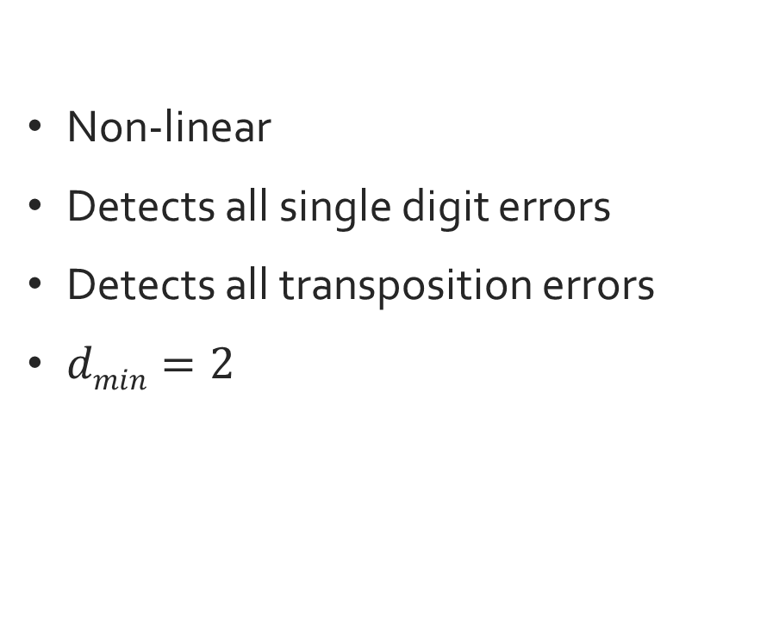
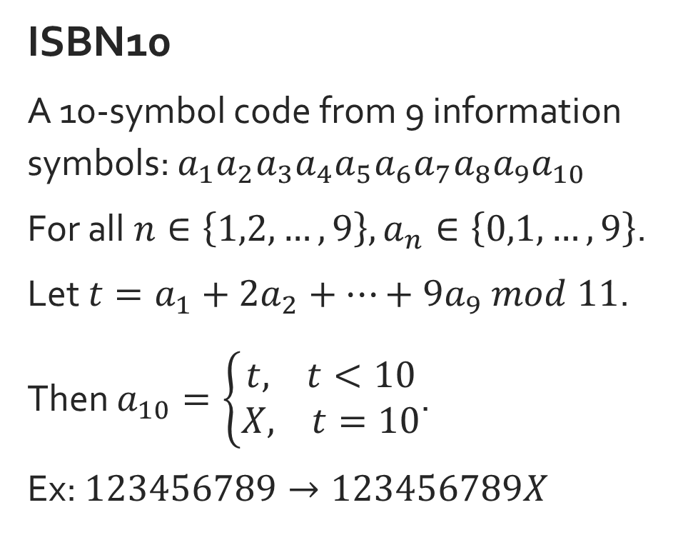
Example Codes
ISBN10
A 10-symbol code from 9 information symbols: $a_{1}a_{2}a_{3}a_{4}a_{5}a_{6}a_{7}a_{8}a_{9}a_{10}$
For all$n∈\left\{1,2,…,9\right\}, a_{n}∈\left\{0,1,…,9\right\}$.
Let $t=a_{1}+{2a}_{2}+…+{9a}_{9} mod 11$.
Then $a_{10}=\left\{\begin{matrix}t, t<10 \\ X, t=10\end{matrix}\right.$.
Ex: $123456789→123456789X$
Non-linear
Detects all single digit errors
Detects all transposition errors
$dmin=2$

Slide 11
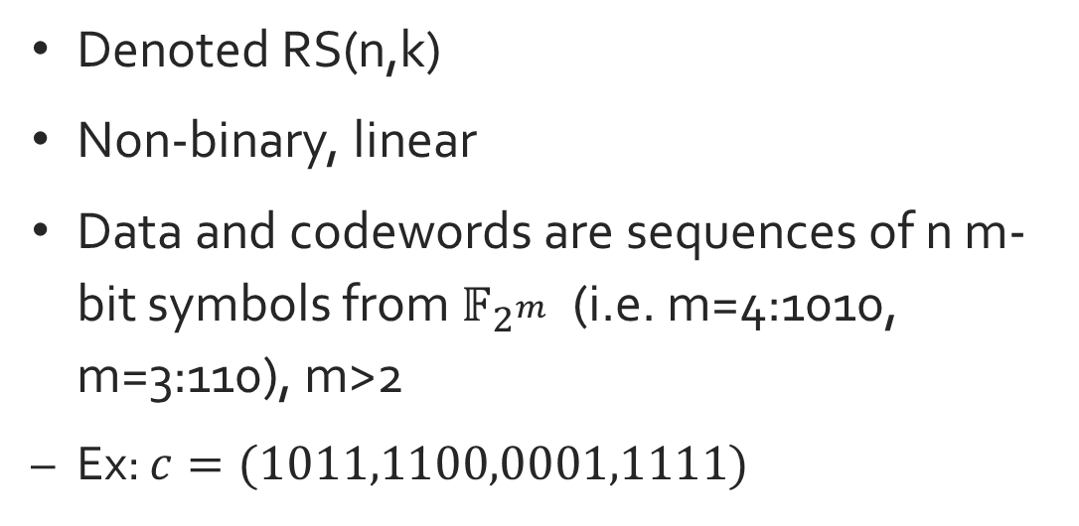
Reed-Solomon Codes Introduction
Denoted RS(n,k)
Non-binary, linear
Data and codewords are sequences of n m-bit symbols from $𝔽_{2^{m}}$ (i.e. m=4:1010, m=3:110), m>2
Ex: $c=(1011,1100,0001,1111)$

Slide 12
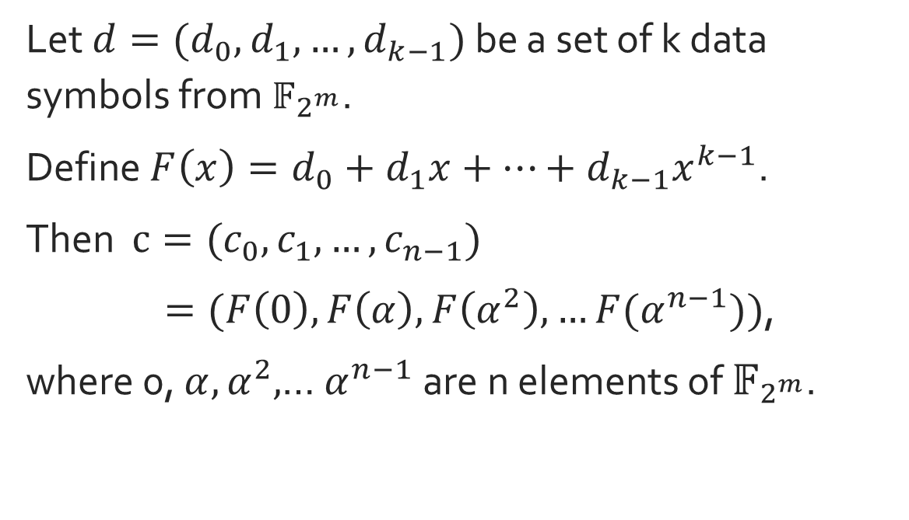
Reed-Solomon Codes Deriving Codewords
Let $d={(d}_{0},d_{1},…,d_{k−1})$ be a set of k data symbols from $𝔽_{2^{m}}$.
Define $F\left(x\right)=d_{0}+d_{1}x+…+d_{k−1}x^{k−1}$.
Then $c={(c}_{0},c_{1},…,c_{n−1})$
$=(F\left(0\right),F\left(α\right),F\left(α^{2}\right),…F(α^{n−1}))$,
where 0, $α,α^{2},$… $α^{n−1}$ are n elements of $𝔽_{2^{m}}$.

Slide 13
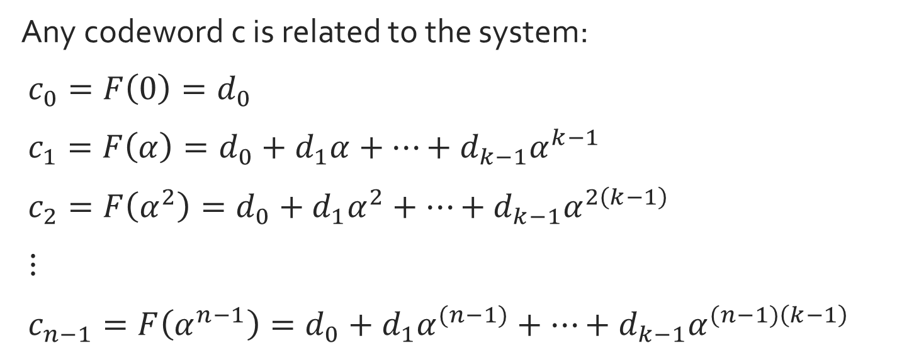
Reed-Solomon Codes Decoding Codewords
Any codeword c is related to the system:
$c_{0}=F\left(0\right)=d_{0}$
$c_{1}=F\left(α\right)=d_{0}+d_{1}α+…+d_{k−1}α^{k−1}$
$c_{2}=F\left(α^{2}\right)=d_{0}+d_{1}α^{2}+…+d_{k−1}α^{2\left(k−1\right)}$
$⋮$
$c_{n−1}=F\left(α^{n−1}\right)=d_{0}+d_{1}α^{(n−1)}+…+d_{k−1}α^{(n−1)\left(k−1\right)}$

Slide 14
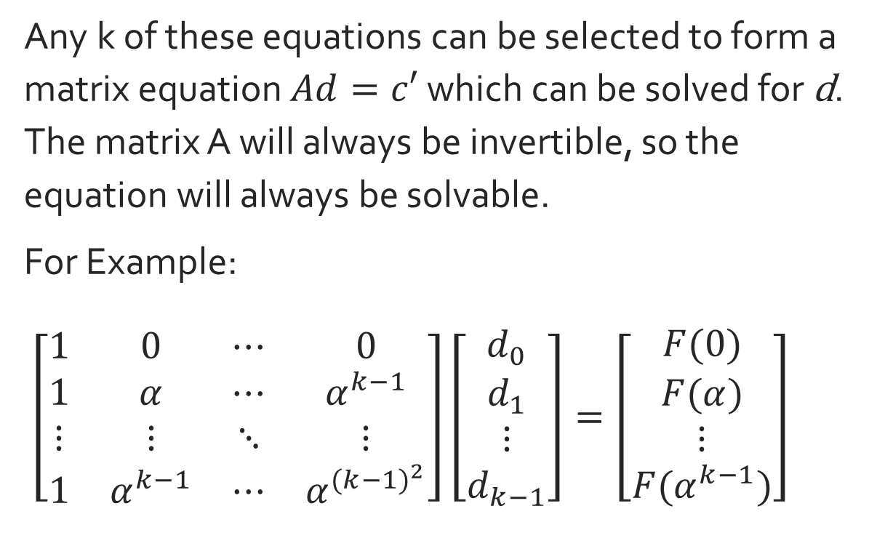
Reed-Solomon Codes Decoding Codewords
Any k of these equations can be selected to form a matrix equation $Ad=c′$ which can be solved for d. The matrix A will always be invertible, so the equation will always be solvable.
For Example:
$\left[\begin{matrix}1 & 0 & ⋯ & 0 \\ 1 & α & ⋯ & α^{k−1} \\ ⋮ & ⋮ & ⋱ & ⋮ \\ 1 & α^{k−1} & ⋯ & α^{{(k−1)}^{2}}\end{matrix}\right]\left[\begin{matrix}d_{0} \\ d_{1} \\ ⋮ \\ d_{k−1}\end{matrix}\right]=\left[\begin{matrix}F(0) \\ F(α) \\ ⋮ \\ F(α^{k−1})\end{matrix}\right]$

Slide 15
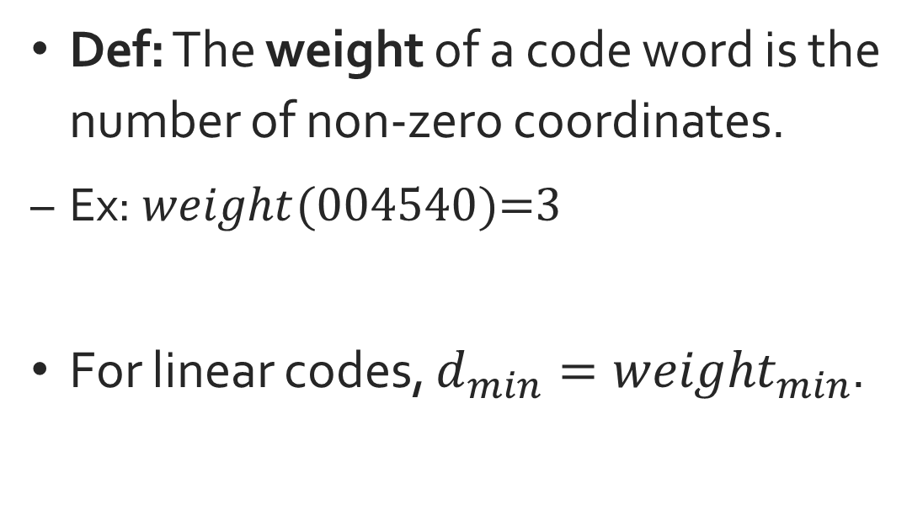
Codes Weight
Def: The weight of a code word is the number of non-zero coordinates.
Ex: $weight(\text{004540)=3}$
For linear codes, $d_{min}={weight}_{min}$.
Notes:
Explain “alphabet”.
Conditions for a vector subspace

Slide 16
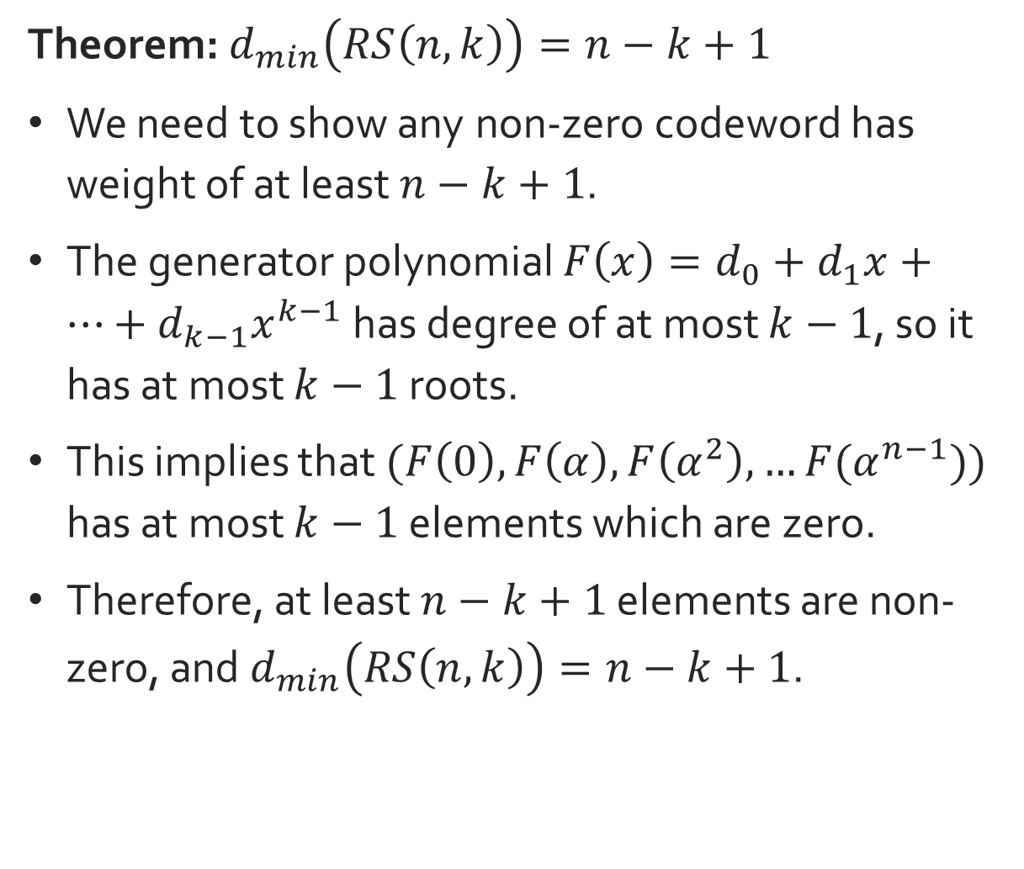
Reed-Solomon Codes Minimum Distance
Theorem: $d_{min}\left(RS\left(n,k\right)\right)=n−k+1$
We need to show any non-zero codeword has weight of at least $n−k+1$.
The generator polynomial $F\left(x\right)=d_{0}+d_{1}x+…+d_{k−1}x^{k−1}$ has degree of at most $k−1$, so it has at most $k−1$ roots.
This implies that $(F\left(0\right),F\left(α\right),F\left(α^{2}\right),…F(α^{n−1}))$ has at most $k−1$ elements which are zero.
Therefore, at least $n−k+1$ elements are non-zero, and $d_{min}\left(RS\left(n,k\right)\right)=n−k+1$.

Slide 17
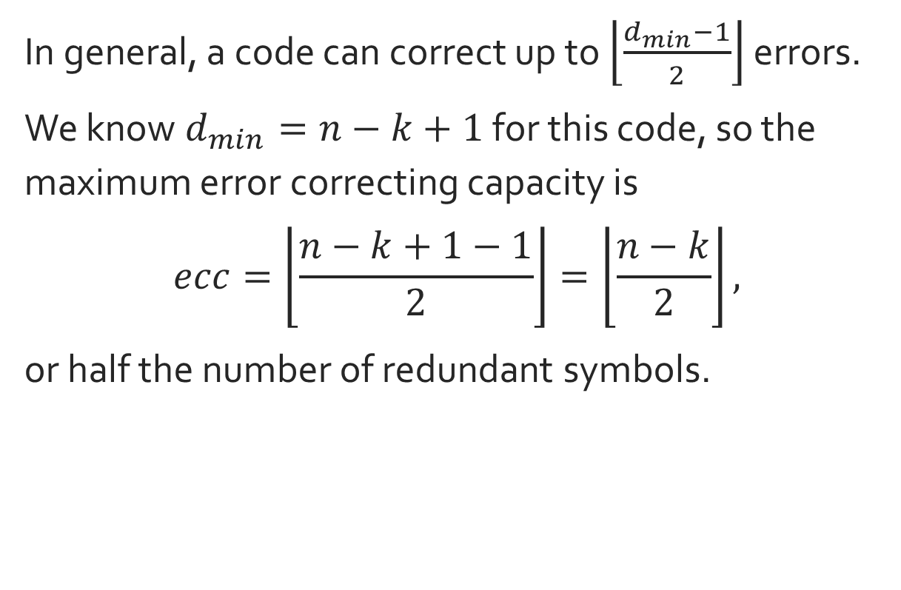
Reed-Solomon Codes Correction Limit
In general, a code can correct up to $\left\lfloor \frac{d_{min}−1}{2}\right\rfloor$ errors.
We know $d_{min}=n−k+1$ for this code, so the maximum error correcting capacity is
$$ecc=\left\lfloor \frac{n−k+1−1}{2}\right\rfloor =\left\lfloor \frac{n−k}{2}\right\rfloor ,$$
or half the number of redundant symbols.

Slide 18
Conclusion
Reed-Solomon Codes have optimal efficiency
Different codes are more suitable for different applications
Reed-Solomon Codes work well for ‘burst errors’

Slide 19
References
Kenyon College. “Introduction to Coding.” Accessed April 17, 2017. http://www2.kenyon.edu/Depts/Math/Aydin/Teach/Fall06/328/Intro.pdf.
Venkatesan Guruswami. “Reed-Solomon, BCH, Reed-Muller, and concatenated codes” Accessed April 17, 2017. https://www.cs.cmu.edu/~venkatg/teaching/codingtheory/notes/notes6.pdf.
Raymond Hill. A First Course in Coding Theory. New York: Oxford University Press, 1991.
Dave K. Kythe and Prem K. Kythe. Algebraic and Stochastic Coding Theory. Boca Raton: CRC Press, 2012.
Martyn Riley and Iain Richardson. “Reed-Solomon Codes.” Accessed April 17, 2017. https://www.cs.cmu.edu/~guyb/realworld/reedsolomon/reed solomon codes.html.
Judy L.Walker. Codes and Curves. Providence, RI: American Mathematical Society, 2002.

